Slide 1
Capital Financing for Energy – Related Projects
George Williams, SVP and Chief Operating Officer
El Paso Electric Company
May 20, 2010

Slide 2
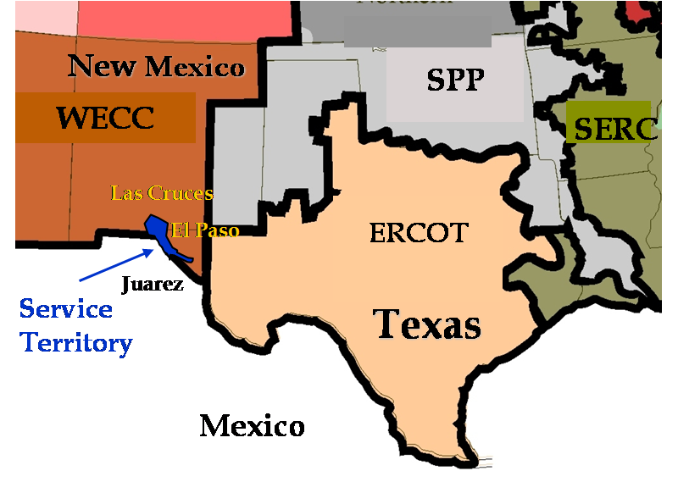
El Paso Electric Overview
Customers Served:
372,080
Size of Service Area (Texas/New Mexico) 10,000 Sq. Miles
Energy Mix
Nuclear Fuel ….... 633 MW……..45%
Coal ………………104 MW …...…7%
Purchased Power …....................26%
Natural Gas ...........905 MW …...22%
Wind & Solar………1.5 MW

Slide 3

El Paso Electric’s Carbon Footprint
2008
EE 0.31
National average 0.67
Source: El Paso Electric’s (“EE”) carbon footprint rate was calculated from information based in its 2008 10K filing and from eGRID – a source of environmental data for U.S. electric power plants that is issued by the Environmental Protection Agency. The national average rate was obtained from the Carbon Monitoring for Action website (www.carma.org).

Slide 4
Electric Utility Business Models
Regulated Business Model
Core Business Extensions
- Merchant Generation
- Merchant Transmission

Slide 5
Capital Investment Considerations
Capital investment and analysis assumptions include:
Cost of Debt (Interest Rate)
Amortization Schedule
Recourse vs. Non-Recourse Debt
Capital Structure
Cost of Equity
Leasing or Other Specialized Structures (although limited)
Purchase Power Agreements (PPAs) in lieu of generation and technology risk

Slide 6
Renewable Generation Limitations
Firm Capacity (wind does not always blow and sun does not always shine)
Cost (and recovery)
Technology
Economical Transmission Interconnections
Economical Storage (i.e., batteries)

Slide 7
PPA Considerations
History of Technology (performance) where risk is also shifted to Seller
Risk technology transference
Performance and reputation of Seller
Cost (and recovery)
Availability of facility
Structure if special purpose entity utilized

Slide 8
Business Model
Core Business
- Regulated
- Merchant Transmission and Generation
Technology Challenges
Reasonable Returns

Slide 9
Capital Financing for Energy – Related Business: Profit Business Model
George Williams, SVP and Chief Operating Officer
El Paso Electric Company
May 20, 2010

